Slide 1
Apama Training
Introduction and
Architecture
Dr Matthew Johnson
Apama R&D

Slide 2
Outline
1.
Apama Introduction
2.
Worked Exercises
3.
Apama in the Cloud
4.
Apama Integration

Slide 3
Training Prerequisites
To participate in this training you will need:
A laptop
Apama installed (e.g. http://apamacommunity.com/downloads)
A copy of the training project + docs (see email)
A copy of the training Type Repository (see email)
Docker client tools (see email)

Slide 4
Apama Introduction

Slide 5
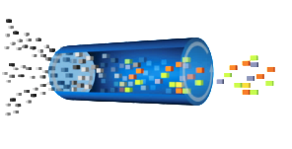
What is Apama
Apama is an in-memory system for Complex Event Processing (CEP) and Streaming Analytics based on a specialist Domain Specific Language (DSL) and a high performance language runtime
Events In
Events Out
This is called the Correlator

Slide 6
What is Apama for
Streaming analytics: analyzing real-time data, as it arrives, producing either actions based on that data, or a refined, higher value, stream of real-time data
General-purpose programming language can do any sort of analytics or processing
Pre-aggregation or filtering in either an ML or edge context
Best at:
High event volume to entity ratio
Low match rate
Calculations on aggregate data
High volume of small events
Stateful analytics

Slide 7
What is Apama Not for
Don’t use Apama for:
A message bus
A data store
Pure integration
You need to be careful with your design and architecture if you have:
A large (>>100k) number of entities in the system
Complex logic that happens on every single event
Externalized state
Apama by itself is an ‘expert tool’ needing programmer engagement.
See tools like Analytics Builder, Smart Rules etc for ways for non-programmers to code in Apama.

Slide 8
KEY APAMA CONCEPTS
Correlator
The central process which holds the EPL runtime and the in-process adapters
EPL
Event Programming Language
A domain-specific language for writing event-based applications
Context
The Apama micro-threading architecture for parallelism
Monitor
The unit of EPL code deployed into the correlator
Connectivity plugins
How integration with external systems is written

Slide 9






What is the correlator?
Server process
Starts empty, deploy applications
Event-based IO
Platforms
Notes:
Server process (connect over network – http or proprietary protocol for events)
Starts empty
Inject event definitions, EPL applications
Can delete, re-inject
Event-based IO
Connect adapters, clients, dashboards – send/ receive events
Platforms
Windows 64 bit (GUI elements only on Windows)
Linux 64 bit
ARM 32 bit
Correlator is mostly C++
Optionally runs embedded JVM (for Java monitors, Java plugins, JMS, dist. memstore integration)

Slide 10
What is EPL?
Event driven
Non-blocking
Dynamic
Actor based
Notes:
EPL is event driven
Information is passed as events
Enforces loose coupling
Consequently makes adapting to changes and extending applications faster and easier
Non-blocking
No blocking primitives
Waiting for a future event involves setting up a listener and then yielding
Always lively
Listeners are very dynamic
Typically created and destroyed thousands of times per second
Actor based
“monitors” are the unit of encapsulation
Also very dynamic

Slide 11





Apama Devops Tooling
Designer
Local
Correlator
Deployment
Source
Control
Testing
Docker
Image
Build
Testing
Deployment
Develop
Test
Package
Deploy
Notes:
CI / CD
Create projects in Software AG Designer
Build project source from source control with automatable command-line tools
Automated testing tools
Entire CI / CD pipeline automatable within Docker
Require automated tests to pass before publishing images / deploying
Parameterizable for dev / test / prod deployments
Testing
Ships with open-source testing framework PySys and Apama-specific extensions
Generic python-based system/integration testing framework
Easy to use and full power of python
Extensible
Automatable
Unit test frameworks for EPL and connectivity plug-ins

Slide 12

Worked Exercises

Slide 13


Exercise Architecture
Robot Sensor Simulator
Management
Dashboard
Messaging
Connection
Apama Analytics
Apama Analytics
Apama Analytics

Slide 14
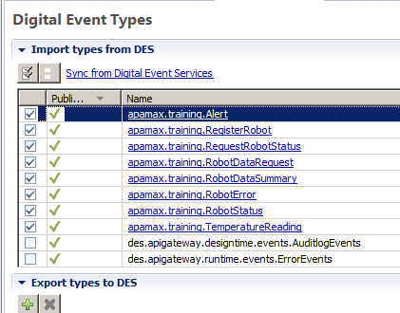
Importing and Connecting to DES
CLASS WORK
Open Project from Filesystem
The project has been pre-configured with the connection to UM
Copy TypeRepository from inside the project to: C:/SoftwareAG/common/ DigitalEventServices/TypeRepository/
You need to import the specific types you want to use. You can get this dialogue by opening config/connectivity/ DigitalEventServices/ EventTypeList.apamades.
Save the page once you’ve added the types

Slide 15
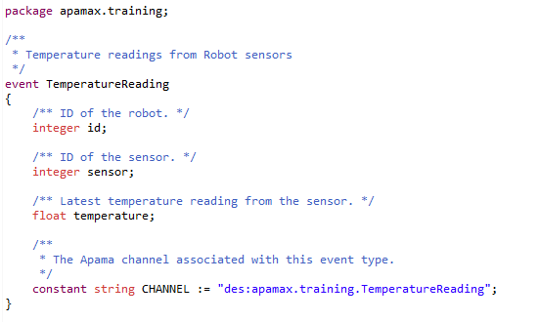
An Apama EVENT
CLASS WORK
This is the main type of event we’ll start looking at in the training
It has fields of primitive types
It has a constant for sending and receiving events of this type
Events can also have actions to provide utility code

Slide 16
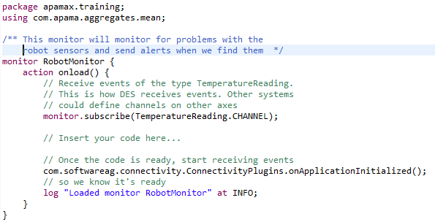
Basic Apama Application
CLASS WORK
In monitors/RobotMonitor.mon is a basic Apama monitor.
The basic component of an Apama program is a monitor. It has an onload action which is run at startup.
This subscribes to a DES channel, signals that it’s ready to receive events and then logs to tell us so
There’s a space for us to insert code to actually do something

Slide 17
Exercises #1
CLASS WORK
Send a one-off test Alert from your application (substitute your name):
send Alert(“Matt”, “Test alert”) to Alert.CHANNEL;
Now Run your code as an Apama Application. The console should show the Apama log output and your alert should show on my dashboard.
Stop it when you’re done so we can make more changes
Receive sensor events and alert the temperature: on all TemperatureReading(id=1, sensor=1) as tr { send Alert(“Matt”, “Temperature for sensor 1 is ” +tr.temperature.toString()) to Alert.CHANNEL; }

Slide 18
Exercises #2
CLASS WORK
Alert for any sensor above a threshold: on all TemperatureReading(temperature > 40.0) as tr { send Alert(“Matt”, “Temperature for robot ” + tr.id.toString() + “ is ” + tr.temperature.toString()) to Alert.CHANNEL; }
Look for multiple related events in series: on all TemperatureReading(id=5, sensor=1, temperature > 40.0) as tr1 -> TemperatureReading(id=5, sensor=2, temperature > 40.0) as tr2 within(10.0) { send Alert(“Matt”, “Temperature for both sensors above threshold”) to Alert.CHANNEL; }

Slide 19
Exercises #3
CLASS WORK
Aggregate temperature and warn on aggregate threshold: from tr in all TemperatureReading() within 10.0 group by tr.id, tr.sensor having mean(tr.temperature) > 40.0 select TemperatureReading(tr.id, tr.sensor, mean(tr.temperature)) as mr { send Alert(“Matt”, “Average temperature for ” + mr.id.toString()+ “ is ” + mr.temperature.toString()) to Alert.CHANNEL; }

Slide 20
Exercises #4
Group Work
(Now it’s your turn)
Temp varies more than +/- 1 degree
Two temperature sensors on one robot more than 5 degrees difference
Show count of how many robots exist
Robot exists but isn’t sending data
Robot is reporting explicit errors
Temperature spikes outside historic range
Temperature updates less than every 2s
Show min/max/mean values for each sensor
Get list of all robots with their state
A temperature sensor is stuck
A robot only sends values for one sensor
Temperature sensor is on average increasing over time
Robot with temperature outside the range of the other robots
Anything else interesting you might be able to calculate or monitor for – I want to see your ideas!

Slide 21
Apama in the Cloud

Slide 22
Running an apama application in the cloud
CLASS WORK
Right click on the project and select Apama -> Add Docker Support
Open a command window and browse to the project
Setup connection to the Docker server: set DOCKER_HOST=hydra.apama.com:2375
Build the project as an image (replace with your username): docker build -t username/client client_project
Run it in the cloud: docker run --rm --name username -d username/client
Check the logs, then stop and delete it: docker logs -f username docker stop username

Slide 23
Apama Integration

Slide 24




Integration points
Out-of-process
Adapters
In-process adapters
EPL Extensions
Legacy external IAF-based adapters
Client APIs
Apama
IAF
Apama
Correlator
In-process
Adapters
Client
APIs
Language
Extensions
Notes:
In-process adapters
Extensible in C++, Java
Standard, interchangeable mapping rules and content decoders
Existing adapters for MQTT, Kafka, UM message busses, HTTP REST client / server, Cumulocity
Existing codecs for JSON, mapping rules. Community-provided codecs for other formats.
JMS framework (Not using standard mapping rules)
EPL Extensions
Extensible in C++, Java and Python
Existing plug-ins for R, Matlab, Terracotta, Zementis, Quantlib (GCS)
Legacy external IAF-based adapters
Extensible in C, Java
Existing adapters for Capital Markets, Databases, WebServices
Client APIs in Java, C++

Slide 25
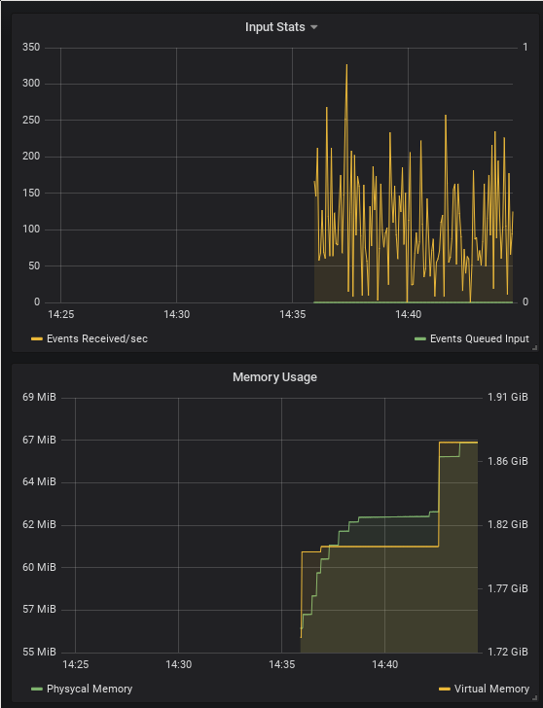

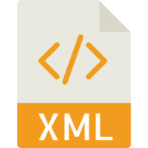






Management and Monitoring
DEMO
Notes:
Designer integration for profiling and debugging
Command-line management tools
Generic REST API for statistics monitoring
JSON or XML
System statistics and application-specific metrics
Java / C++ APIs for custom clients
Prometheus / Grafana consume metrics
CommandCentral consume metrics
O4I consume metrics

Slide 26



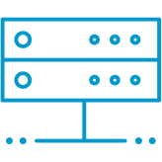
External products
Databases
SOAP
JMS
Other messaging
Databases
Webservices
Capital markets
Apama
IAF
Finance
Apama
Correlator
JMS
Message Busses
REST
Notes:
Supported JMS busses
Universal Messaging, HornetQ, RabbitMQ, WebLogic, WebSphere
Other messaging
Kafka, MQTT
Supported Databases
Uses the DataDirect drivers
Oracle, MySQL, DB2, MSSQL
Web-based integration
REST via in-process adapter (client and server)
SOAP via legacy IAF adapter (but use wMIS)
Capital Markets
Many market data feeds, often FIX-base

Slide 27

SAG Products via DES
UM + Protobuf
Automatic mapping
Designer integration
Apama
Designer
DES
Universal messaging
Mashzone
Integration server
Notes:
UM-based messaging with Google Protobuf encoding
Automatic mapping between IS Doctypes, Apama events and wire format
Can author types in IS or Apama*
Designer integration
One channel per message type
Supports reliable messaging

Slide 28




Universal Messaging
Apama
JMS or Native
Multiple protocols
Multiple languages
Universal messaging
Notes:
Universal Messaging provides integration with a very large number of external systems
Multiple messaging protocols
Multiple client languages (including JavaScript)
Apama has native integration with UM which can talk to any other client using any protocol
Use multiple pre-defined or custom mapping codecs
Note: No reliable messaging, topics only
Also can use JMS to talk to UM which does support reliable messaging and queues.
But harder to use non-XML encodings

Slide 29

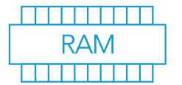

Terracotta
EPL Storage plugin:
In-memory
On-disk
Terracotta
Share data
Between contexts/monitors (in-memory)
Between correlators (BigMemory)
Between products (TerracottaDB)
Apama
Terracotta
Notes:
Apama provides an EPL plugin which can store data for sharing between Monitors and Contexts.
This can be an in-memory store, an on-disk store, or Terracotta
Disk store is persisted from in-memory on-demand
Key-Multi Value store (NoSQL)
Synchronous writes
Support for Terracotta DB and BigMemory
Terracotta allows sharing of the store data between multiple correlators
Terracotta DB allows sharing of the store data to non-Apama clients

Slide 30


Zementis
Model execution
Apama data cleaning
Apama integration
Zementis:
Embedded
External
Zementis
Apama
Notes:
EPL Plugin to embed the Zementis engine in Apama
Data analytics offline to build a model
Load the model into Zemetis through Apama
Apama provides pre-filtering and data normalization for real-time streams
Model execution as part of handling an event via the plugin
Make use of Apama’s integration for data sources and sinks
Can also invoke models in the Zementis server via the HTTP client

Slide 31
Mashzone
Suite dashboarding
Integration via:
DES
Terracotta DB
Direct
Send events to Apama
Apama
Terracotta
Universal messaging
Mashzone
Notes:
In addition to Apama’s SL-based real-time dashboards can also display data in Mashzone
Mashzone can accept data via DES
Mashzone can read Terracotta DB tables written by Apama
Mashzone can connect directly to Apama via the Scenario Service / Dataview API
Mashzone widget for triggering events in Apama from Mashzone UI

Slide 32

Cumulocity
DEMO
Apama
The main 2019 Go-To-Market for Apama
Provides analytic capabilities for Cumulocity:
Smart Rules
Apama EPL upload
Custom microservices / external Apama
Apama thin-Edge (coming soon)
Cumulocity
Apama
Apama
Apama
Apama
Notes:
The main 2019 Go-To-Market for Apama
Provides analytic capabilities for Cumulocity-based applications, in cloud and on premise (Edge)
Consume measurements and other device messages
Produce alerts or device operations in response
Several ways to use Apama with Cumulocity:
Smart Rules
Apama EPL upload
Custom microservices / external Apama
Apama thin-Edge (coming soon)
Analytics Builder

Slide 33
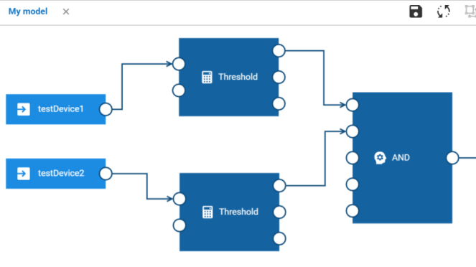


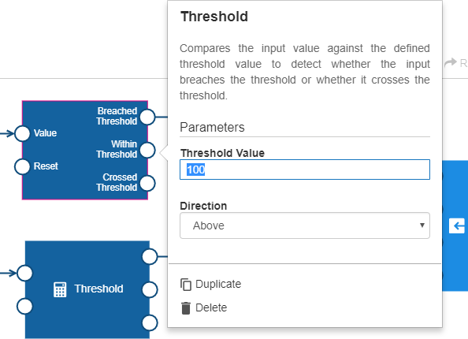
Analytics Builder
DEMO
Drag + Drop GUI
IoT domain experts
Analytics Library or custom EPL
Can write domain-specific blocks with EPL
Cumulocity Edge (April)
Cumulocity Cloud (Soon)
Notes:
Initially built for ADAMOS / Dürr
Graphical UI for non-coders wanting to use streaming analytics
Drag + Drop wiring UI
Designed for domain experts in IoT
Library of pre-built analytics blocks
Can write domain-specific blocks with EPL
Simple block and model-management UI
Cumulocity event sources and sinks
Provided in Cumulocity Edge April release for non-Deurr
Cumulocity cloud coming this year

Slide 34
Some notes on sizing
How much memory does Java need?
Minimums aren’t useful
Similar applications are a guide
Testing testing testing

Slide 35
Questions and Further Reading
Community blog posts: http://www.apamacommunity.com/blog/
Apama documentation: http://www.apamacommunity.com/docs/
This course: https://github.com/SoftwareAG/apama-streaming-analytics-intro-training
Samples in your installation
Training on iLearn
More resources on github:
Official https://github.com/SoftwareAG
Community: https://github.com/ApamaCommunity/Creations-Index

